Slide 1



CSE 315: Artificial Intelligence
Introduction
Green University of Bangladesh

Slide 2
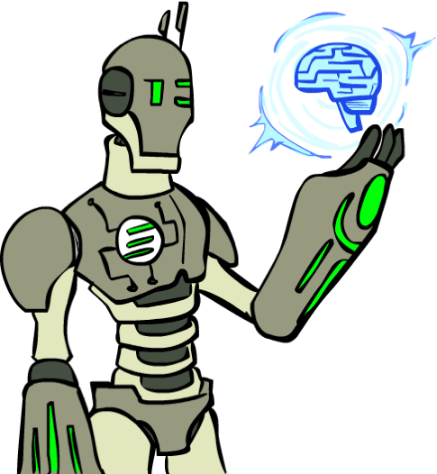
What is AI?
What is artificial intelligence?
What can AI do?
What is this course?

Slide 3

AI is having real-world impact
Public imagination
Text assistants

Slide 4
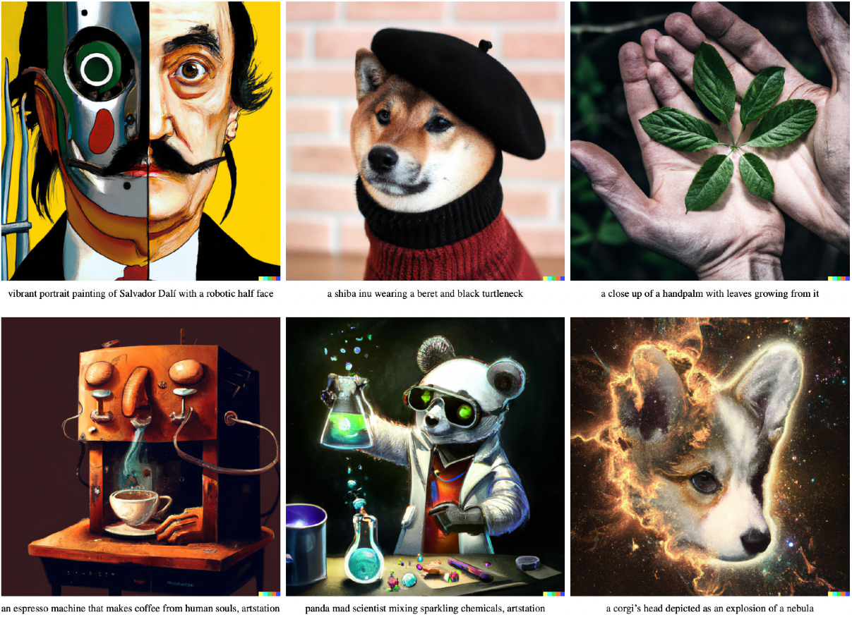
AI is having real-world impact
Public imagination
Text assistants
Image generation
Notes:
most people think about AI in the public imagination, they often picture a few highly visible applications, especially in text and images

Slide 5



AI is having real-world impact

Slide 6
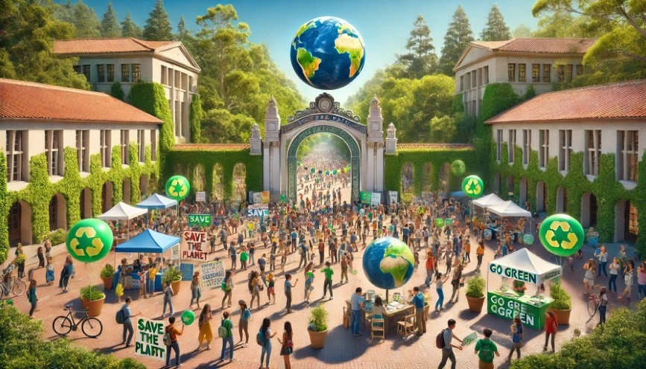
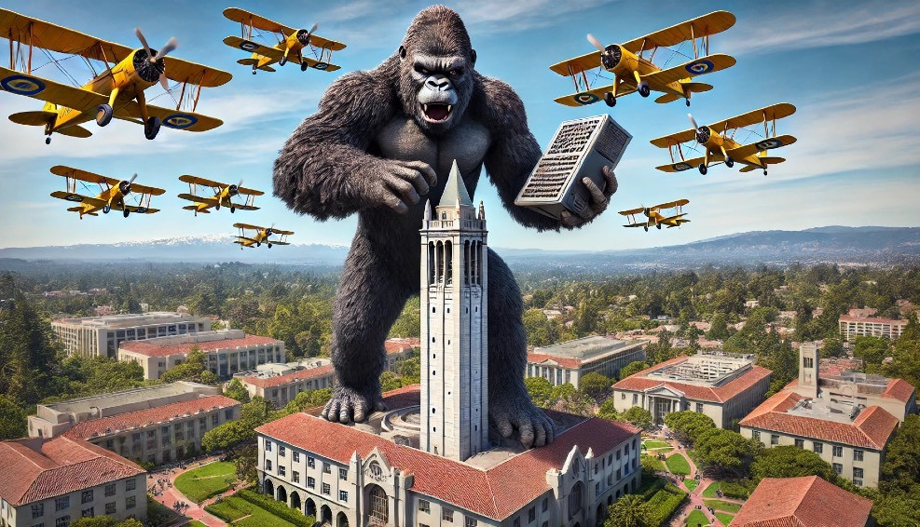

AI is having real-world impact

Slide 7
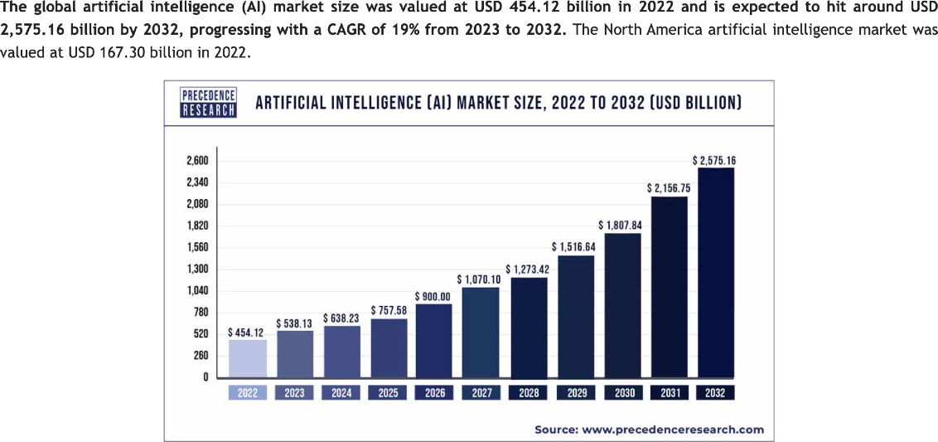
AI is having real-world impact
Public imagination
Economy
454 billion USD globally
https://www.precedenceresearch.com/artificial-intelligence-market

Slide 8
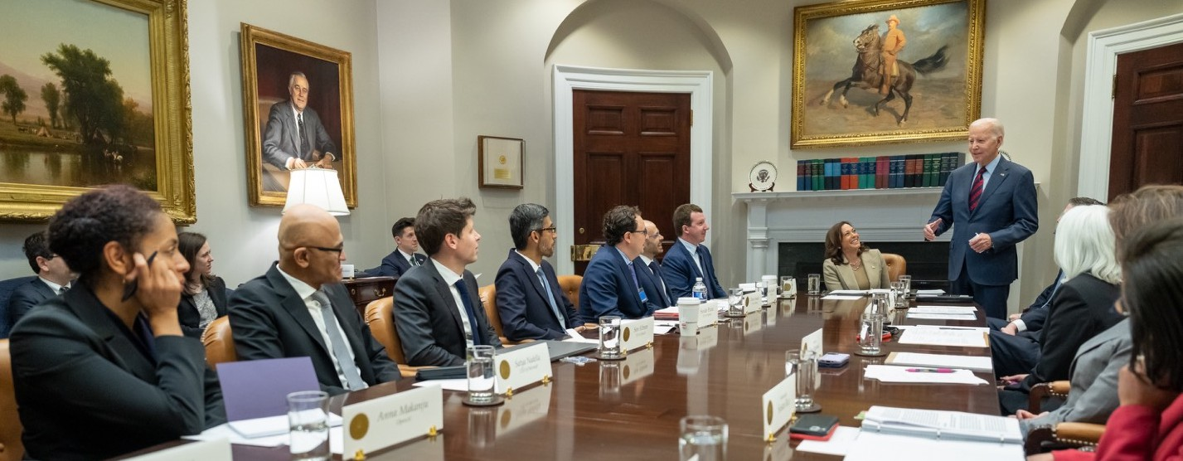
AI is having real-world impact
Public imagination
Economy
Politics

Slide 9
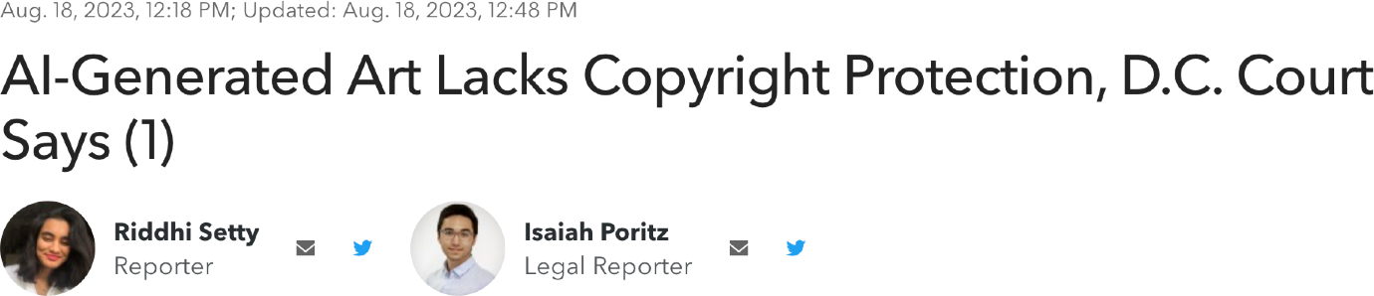
AI is having real-world impact
Public imagination
Economy
Politics
Law
Bloomberg Law, 2023

Slide 10
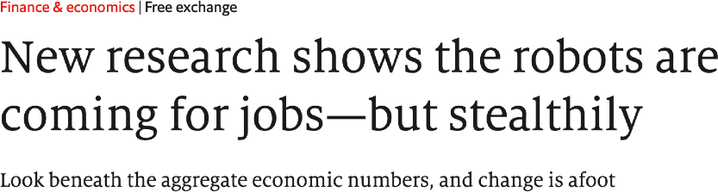
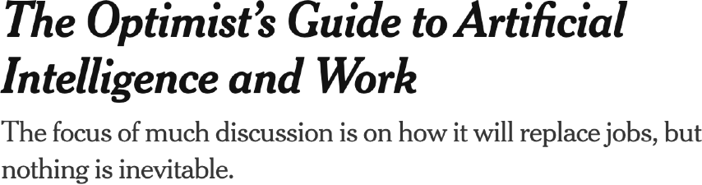
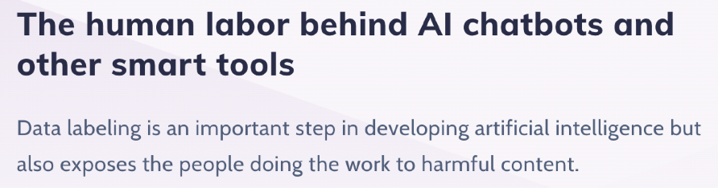
AI is having real-world impact
Public imagination
Economy
Politics
Law
Labor
The Economist, 2021
New York Times, 2023
MarketWatch, 2023

Slide 11
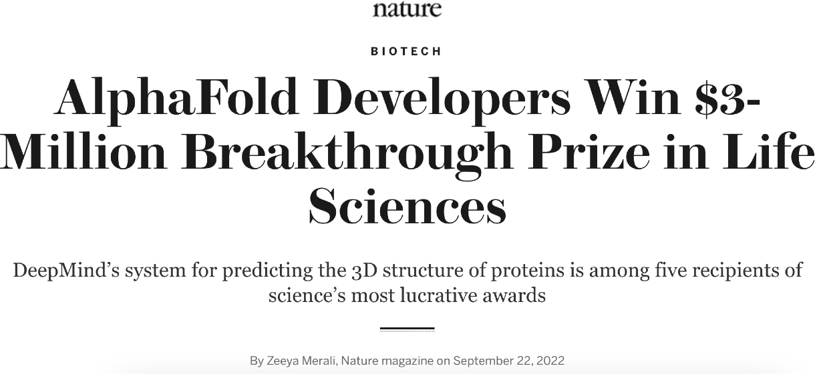
AI is having real-world impact
Public imagination
Economy
Politics
Law
Labor
Sciences
Nature, 2022

Slide 12
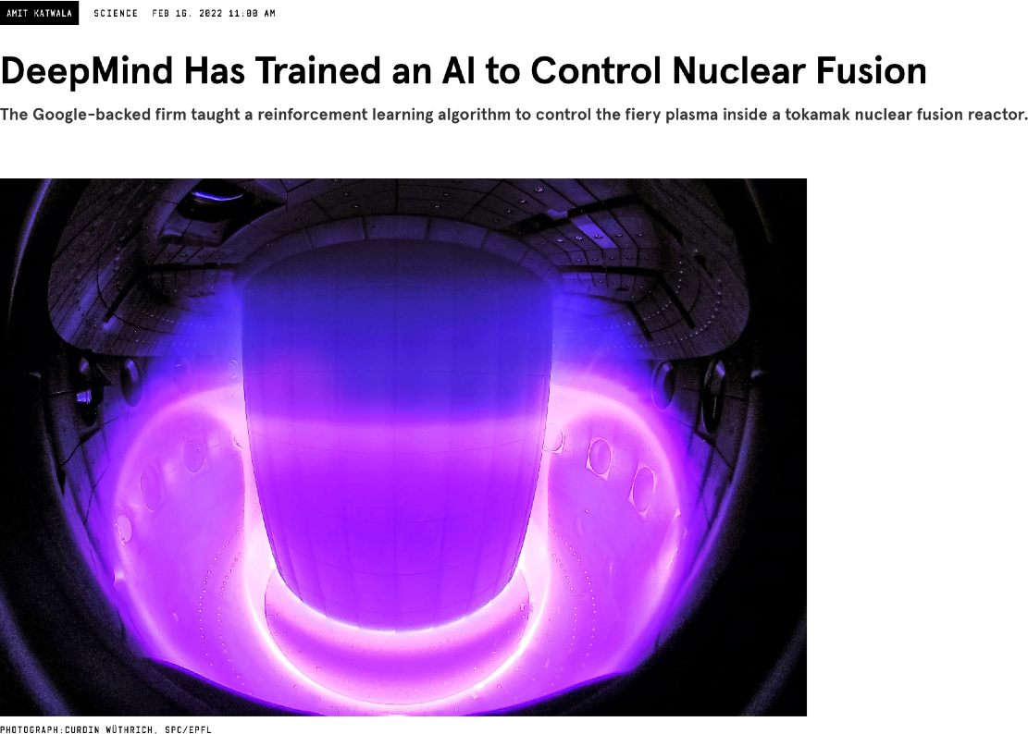
AI is having real-world impact
Public imagination
Economy
Politics
Law
Labor
Sciences
Wired, 2022

Slide 13

AI is having real-world impact
Public imagination
Economy
Politics
Law
Labor
Sciences
Education
Forbes, 2023

Slide 14
AI is having real-world impact
Public imagination
Economy
Politics
Law
Labor
Sciences
Education
Ok, but what does AI do???

Slide 15
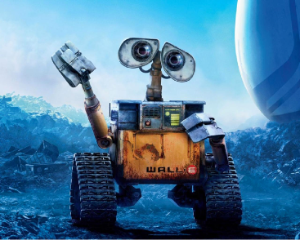
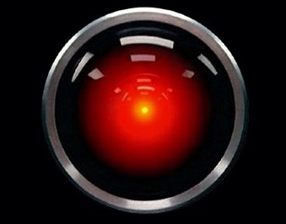
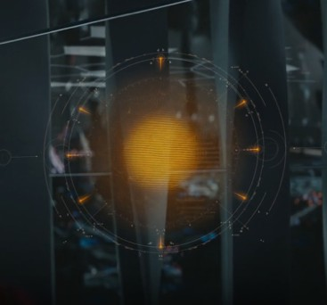
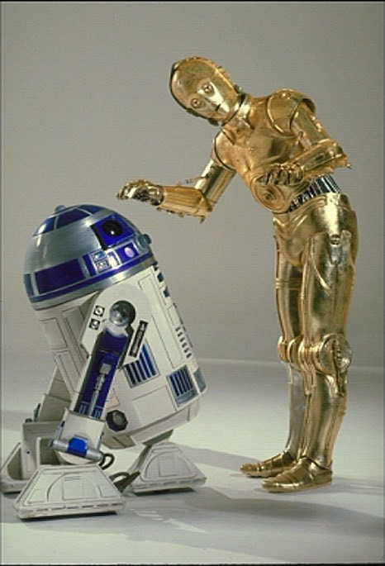
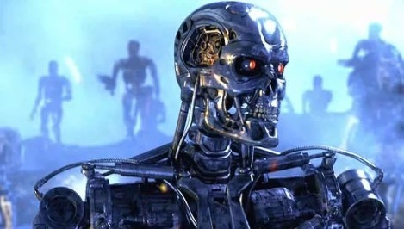

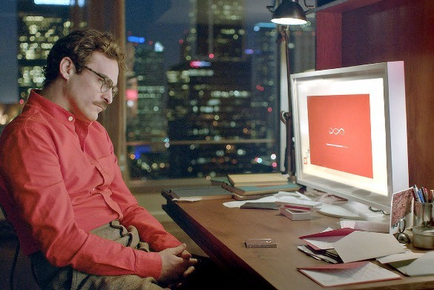

Science fiction AI?

Slide 16
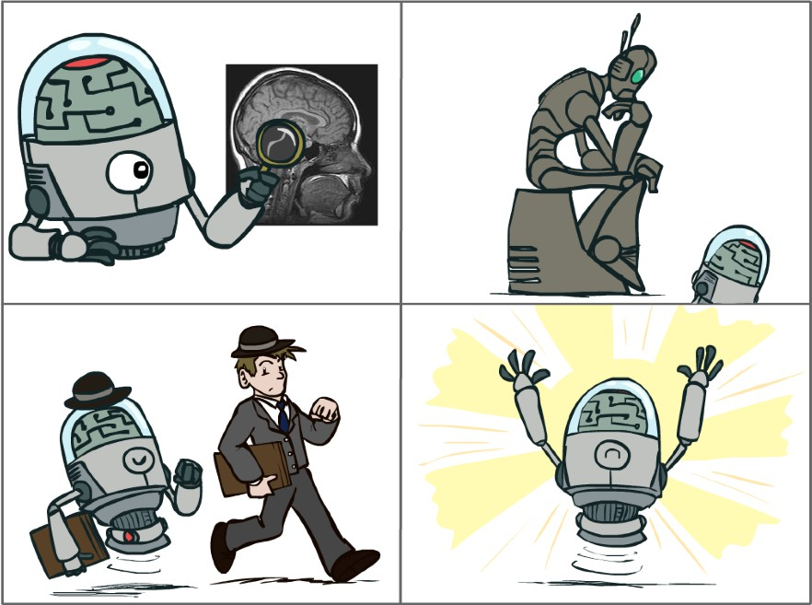
What is AI?
The science of making machines that:
Think like people?
Think rationally?
Act like people?
Act rationally

Slide 17
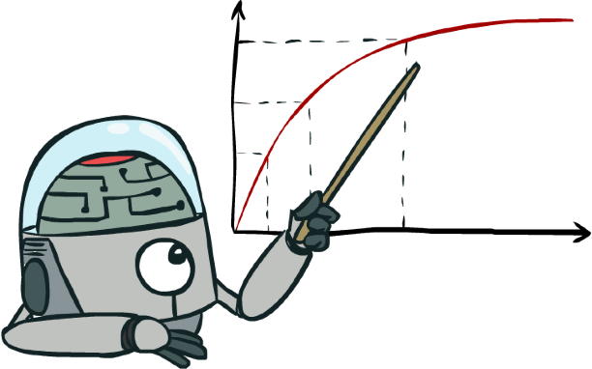
Rational Decisions
We’ll use the term rational in a very specific, technical way:
Rational: maximally achieving pre-defined goals
Goals are expressed in terms of the utility of outcomes
World is uncertain, so we’ll use expected utility
Being rational means acting to maximize your expected utility

Slide 18
Rational Decisions
We’ll use the term rational in a very specific, technical way:
Rational: maximally achieving pre-defined goals
Goals are expressed in terms of the utility of outcomes
World is uncertain, so we’ll use expected utility
Being rational means acting to maximize your expected utility
A better title for this course would be:
Computational Rationality

Slide 19
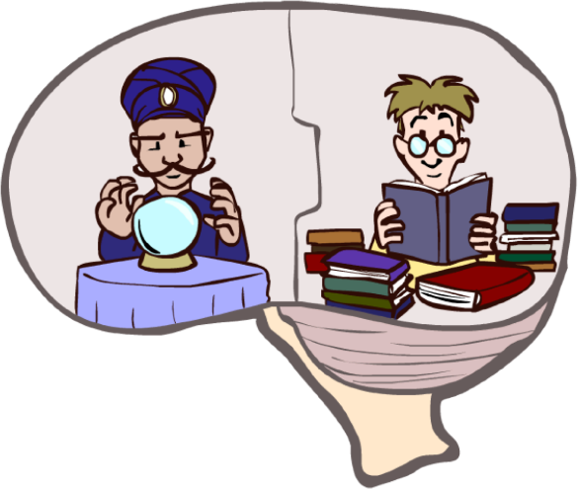
What About the Brain?
Brains (human minds) are very good at making rational decisions, but not perfect
Brains aren’t as modular as software, so hard to reverse engineer!
AI may be better than brains at some tasks
“Brains are to intelligence as wings are to flight”
We can’t yet build AI on the scale of the brain
~100T synapses in the human brain vs ~1.8T weights in ChatGPT4
Still, the brain can be a great inspiration for AI!

Slide 20
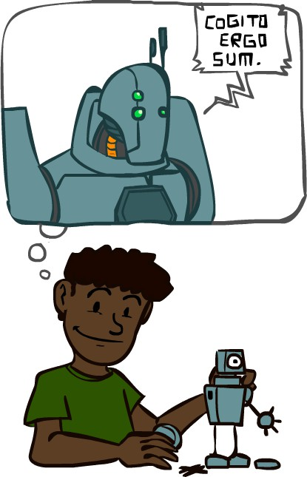
A (Short) History of AI

Slide 21
A (Short) History of AI
1940-1950: Early days: neural and computer science meet
1943: McCulloch & Pitts: Boolean circuit model of brain
1950: Turing's “Computing Machinery and Intelligence”
1950—70: Excitement! Logic-driven
1950s: Early AI programs, including Samuel's checkers program, Newell & Simon's Logic Theorist, Gelernter's Geometry Engine
1956: Dartmouth meeting: “Artificial Intelligence” adopted
1957: Newell, Shaw, Simon GPS, General Problem Solver
1965: Robinson's complete algorithm for logical reasoning

Slide 22

A (Short) History of AI
1970—90: Knowledge-based approaches
1969—79: Early development of knowledge-based systems
1980—88: Expert systems industry booms
1988—93: Expert systems industry busts: “AI Winter”
1990—2010: Statistical approaches
Resurgence of probability, focus on uncertainty
Agents and learning systems… “AI Spring”?
1992: TD-Gammon attains human-level performance
1996: Kasparov defeats Deep Blue at chess
1997: Deep Blue defeats Kasparov at chess
2002: Embodied AI; Roomba vacuum invented
“I could feel --- I could smell --- a new kind of intelligence across the table.” ~Kasparov

Slide 23
A (Short) History of AI
2010—2017: Big Data, GPUs, Deep Learning
2011: Apple releases SIRI
2012: AlexNet (neural net) wins ImageNet (image recognition) competition
2015: DeepMind achieves human-level control in Atari games
2016: DeepMind’s AlphaGo beat Go Master, Lee Sedol
2016: Google Translate migrates to neural networks
2017—: Scaling up, Large Language Models
2017: Google invents Transformer architecture
2017: DeepStack and Libratus defeat humans at poker
2018-2020: AlphaFold predicts protein structure from amino acids
2021-2022: Modern text-to-image generation
2022: OpenAI release ChatGPT

Slide 24
A (Short) History of AI
Notable Failure 1 - Natural Language Processing Efforts
Early work during cold war to translate Russian to English
Success early on followed by reality of serious limitations
Out of sight, out of mind Invisible, Insanity
The spirit is willing, but the flesh is weak The Vodka is strong, but the meat is rotten
Problem: Even simple sentences require world knowledge
Cinderella attended the ball Cinderella kicked the ball
The house was built by the workman The house was built by the river
The soldiers shot the prisoners and I saw several fall The soldiers shot the prisoners and I saw several reload
The pen is in the box The box is in the pen
Attempted Solution: Capture and embody world knowledge

Slide 25
A (Short) History of AI
Notable Failure 2 - Perceptrons
Rosenblatt’s two layer neural nets
Belief was that they could learn logic operations
Minsky and Papert showed that they couldn’t even solve XOR
No mathematical way to reflect that one input’s contribution is greater than that of two: X !> (X+Y)
Solution: Add hidden layer between input layer and output layer

Slide 26
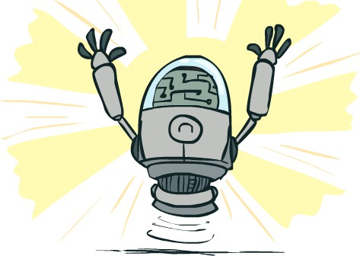
What Can AI Do?
Quiz: Which of the following can be done at present? Win against any human at chess?
Win against the best humans at Go? Play a decent game of tennis?
Unload any dishwasher in any home? Drive safely along the highway?
Drive safely along streets of San Francisco? Buy a week's worth of groceries on the web?
Buy a week's worth of groceries at Berkeley Bowl? Discover and prove a new mathematical theorem? Perform a surgical operation?
Translate spoken Chinese into spoken English in real time? Win an art competition?
Write an intentionally funny story? Construct a building?

Slide 27
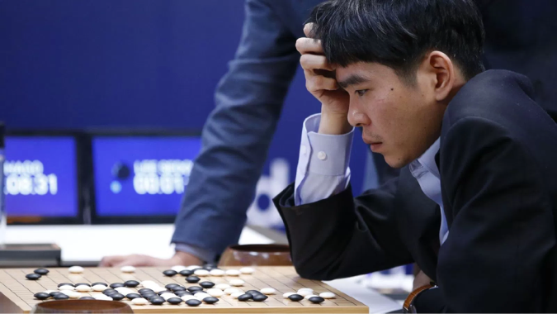
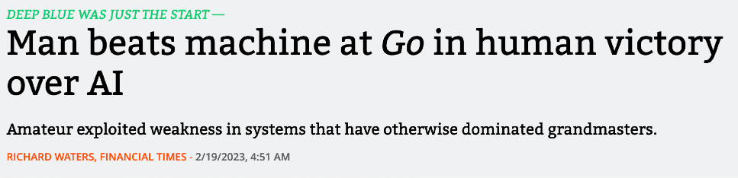
What Can AI Do?
Quiz: Which of the following can be done at present? Win against any human at chess?
Win against the best humans at Go? Play a decent game of tennis?
Unload any dishwasher in any home? Drive safely along the highway?
Drive safely along streets of San Francisco? Buy a week's worth of groceries on the web?
Buy a week's worth of groceries at Berkeley Bowl? Discover and prove a new mathematical theorem? Perform a surgical operation?
Translate spoken Chinese into spoken English in real time? Win an art competition?
Write an intentionally funny story? Construct a building?
Google’s AlphaGo beats Lee Sedol at Go in 2016
But … a plot twist in 2023!

Slide 28
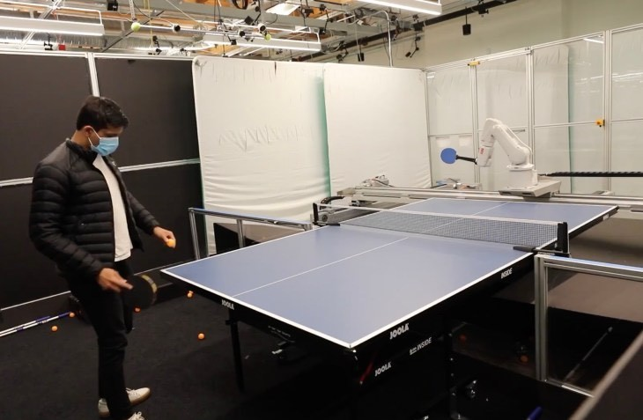
What Can AI Do?
Quiz: Which of the following can be done at present? Win against any human at chess?
Win against the best humans at Go? Play a decent game of tennis?
Unload any dishwasher in any home? Drive safely along the highway?
Drive safely along streets of San Francisco? Buy a week's worth of groceries on the web?
Buy a week's worth of groceries at Berkeley Bowl? Discover and prove a new mathematical theorem? Perform a surgical operation?
Translate spoken Chinese into spoken English in real time? Win an art competition?
Write an intentionally funny story? Construct a building?

Slide 29
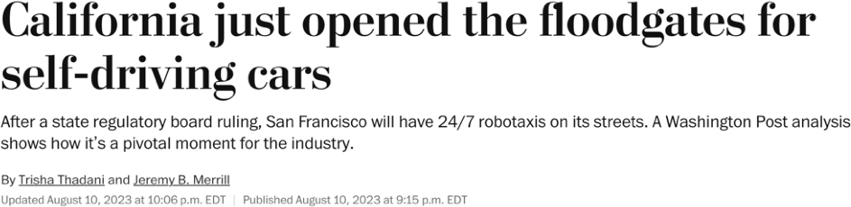

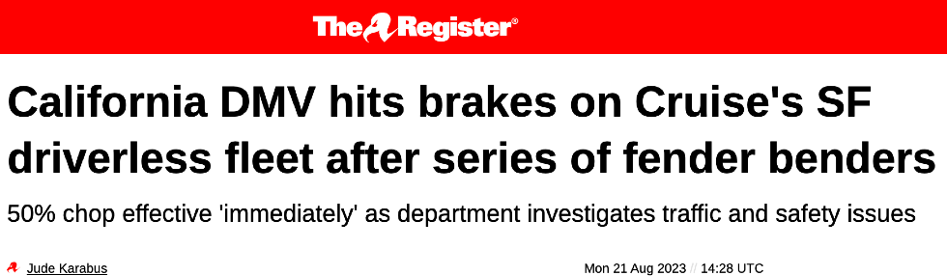
What Can AI Do?
Quiz: Which of the following can be done at present? Win against any human at chess?
Win against the best humans at Go? Play a decent game of tennis?
Unload any dishwasher in any home? Drive safely along the highway?
Drive safely along streets of San Francisco? Buy a week's worth of groceries on the web?
Buy a week's worth of groceries at Berkeley Bowl? Discover and prove a new mathematical theorem? Perform a surgical operation?
Translate spoken Chinese into spoken English in real time? Win an art competition?
Write an intentionally funny story? Construct a building?

Slide 30


What Can AI Do?
Quiz: Which of the following can be done at present? Win against any human at chess?
Win against the best humans at Go? Play a decent game of tennis?
Unload any dishwasher in any home? Drive safely along the highway?
Drive safely along streets of San Francisco? Buy a week's worth of groceries on the web?
Buy a week's worth of groceries at Berkeley Bowl? Discover and prove a new mathematical theorem? Perform a surgical operation?
Translate spoken Chinese into spoken English in real time? Win an art competition?
Write an intentionally funny story? Construct a building?

Slide 31
What Can AI Do?
Quiz: Which of the following can be done at present? Win against any human at chess?
Win against the best humans at Go? Play a decent game of tennis?
Unload any dishwasher in any home? Drive safely along the highway?
Drive safely along streets of San Francisco? Buy a week's worth of groceries on the web?
Buy a week's worth of groceries at Berkeley Bowl? Discover and prove a new mathematical theorem? Perform a surgical operation?
Translate spoken Chinese into spoken English in real time? Win an art competition?
Write an intentionally funny story? Construct a building?
Prompt: Write a joke about an early space program that had used monkeys as astronauts for many missions, and then sent the first human astronaut into space along with a monkey.
In an early space program, after successfully sending monkeys on several missions, they finally decided to send a human astronaut along with a monkey. As the rocket was about to launch, the human nervously asked mission control, "So, what are my instructions?"
Mission control replied, "Relax, we gave the monkey the important stuff to do. You just feed him and make sure he’s comfortable!"

Slide 32
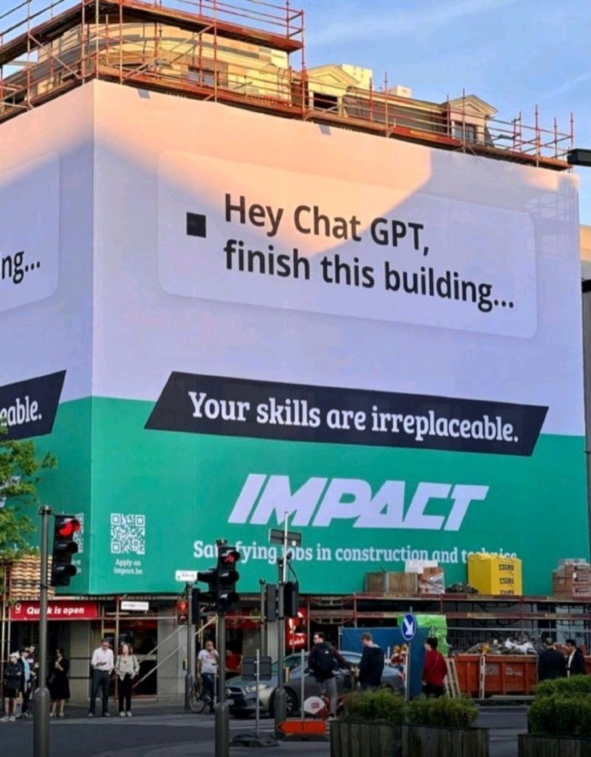
What Can AI Do?
Quiz: Which of the following can be done at present? Win against any human at chess?
Win against the best humans at Go? Play a decent game of tennis?
Unload any dishwasher in any home? Drive safely along the highway?
Drive safely along streets of San Francisco? Buy a week's worth of groceries on the web?
Buy a week's worth of groceries at Berkeley Bowl? Discover and prove a new mathematical theorem? Perform a surgical operation?
Translate spoken Chinese into spoken English in real time? Win an art competition?
Write an intentionally funny story? Construct a building?

Slide 33
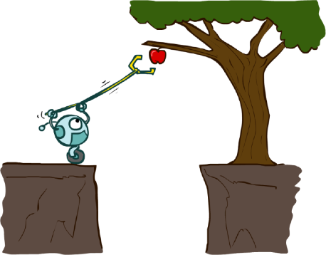
This Course: Designing Rational Agents
An agent is an entity that perceives and acts.
A rational agent selects actions that maximize its (expected) utility.
Characteristics of the percepts, environment, and action space dictate techniques for selecting rational actions
This course is about:
General AI techniques for a variety of problem types
Learning to recognize when and how a new problem can be solved with an existing technique
Sensors
Environment
Percepts
Agent
?
Actuators
Actions

Slide 34
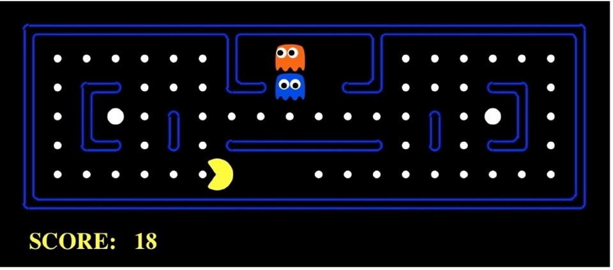
Pac-Man as an Agent
Agent
Sensors
?
Environment
Percepts
Actuators
Actions
Pac-Man is a registered trademark of Namco-Bandai Games, used here for educational purposes

Slide 35
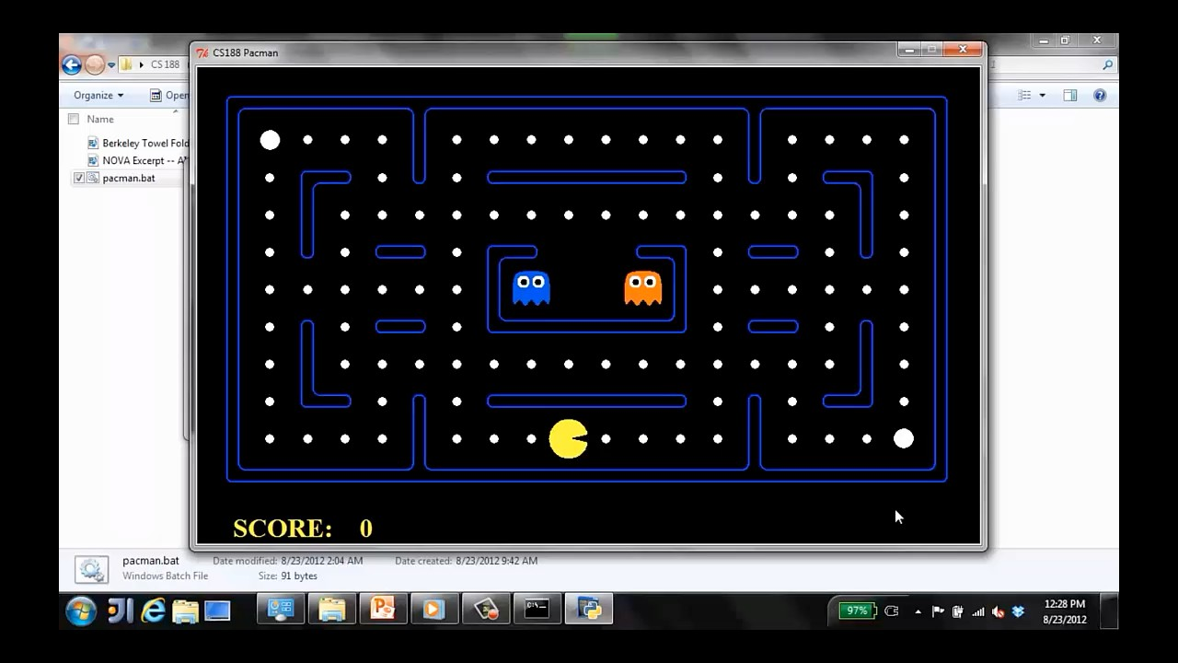

Slide 36
Course Topics
Core Components of Rational Agents:
Search & Planning
Reinforcement Learning
Probability & Inference
Supervised Learning

Slide 37
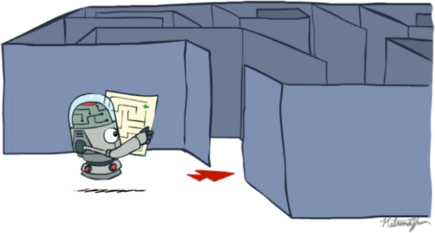
Course Topics
Search & Planning
Reinforcement Learning
Probability & Inference
Supervised Learning
How can I find a sequence of best decisions for a
particular situation?

Slide 38
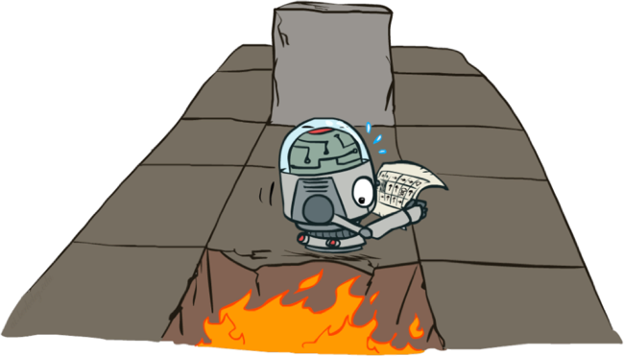
Course Topics
Search & Planning
Reinforcement Learning
Probability & Inference
Supervised Learning
How can I find rules (policy) to make best decisions for any situation?

Slide 39
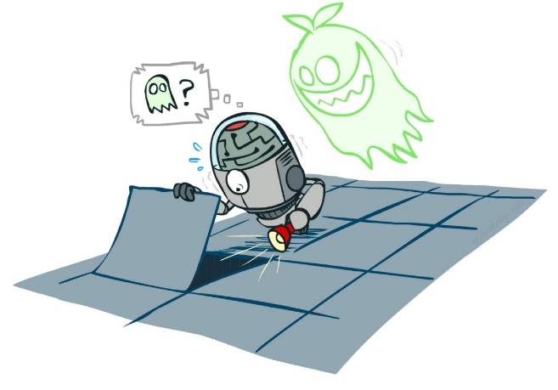
Course Topics
Search & Planning
Reinforcement Learning
Probability & Inference
Supervised Learning
How can I make sense of uncertainty in the world?

Slide 40
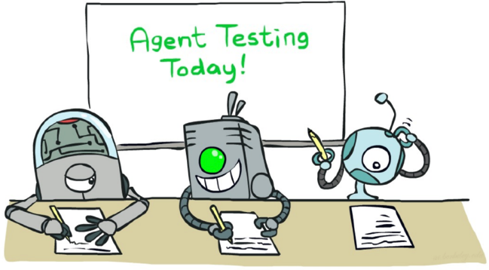
Course Topics
Search & Planning
Reinforcement Learning
Probability & Inference
Supervised Learning
How can I learn a model of the world from data?

Slide 41
Course Topics
Search & Planning
Reinforcement Learning
Intelligence from Computation
Probability & Inference
Supervised Learning
Intelligence from Data/Experience

Slide 42
Course Topics
Search & Planning
Reinforcement Learning
Probability & Inference
Supervised Learning
Applications
Impact on Sciences, Technology, Society

Slide 43
By the end of this course you’ll:
Build and understand math of rational, learning agents
Select and apply the right AI methods for wide range of problems
Recognize how these methods are used in modern AI systems
Be prepared to make decisions on how AI is used in society

Slide 44

Next Class: Search

